Slide 1
Social Responsibility and Managerial Ethics
Chapter
5

Slide 2
L E A R N I N G O U T L I N E
Follow this Learning Outline as you read and study this chapter.
What is Social Responsibility?
  Contrast the classical and socioeconomic views of social responsibility.
  Discuss the role that stakeholders play in the four stages of social responsibility.
  Differentiate between social obligation, social responsiveness, and social responsibility.

Slide 3
L E A R N I N G O U T L I N E
Follow this Learning Outline as you read and study this chapter.
Social Responsibility and Economic Performance
  Explain what research studies have shown about the relationship between an organization’s social involvement and its economic performance.
  Define social screening.
  Explain what conclusion can be reached regarding social responsibility and economic performance.

Slide 4
L E A R N I N G O U T L I N E (cont’d)
Follow this Learning Outline as you read and study this chapter.
The Greening of Management
  Describe how organizations can go green.
  Relate the approaches to being green to the concepts of social obligation, social responsiveness, and social responsibility.
Values-Based Management
  Discuss what purposes shared values serve.
  Describe the relationship of values-based management to ethics.

Slide 5
L E A R N I N G O U T L I N E (cont’d)
Follow this Learning Outline as you read and study this chapter.
Managerial Ethics
  Discuss the factors that affect ethical and unethical behavior.
  Describe the important roles managers play in encouraging ethical behavior.

Slide 6
L E A R N I N G O U T L I N E (cont’d)
Follow this Learning Outline as you read and study this chapter.
Social Responsibility and Ethics in Today’s World
  Explain why ethical leadership is important.
  Discuss how managers and organizations can protect employees who raise ethical issues or concerns.
  Explain what role social entrepreneurs play.
  Describe social impact management.

Slide 7
What Is Social Responsibility?
The Classical View
  Management’s only social responsibility is to maximize profits (create a financial return) by operating the business in the best interests of the stockholders (owners of the corporation).
  Expending the firm’s resources on doing “social good” unjustifiably increases costs that lower profits to the owners and raises prices to consumers.

Slide 8
What Is Social Responsibility? (cont’d)
The Socioeconomic View
  Management’s social responsibility goes beyond making profits to include protecting and improving society’s welfare.
  Corporations are not independent entities responsible only to stockholders.
  Firms have a moral responsibility to larger society to become involved in social, legal, and political issues.
  “To do the right thing”

Slide 9
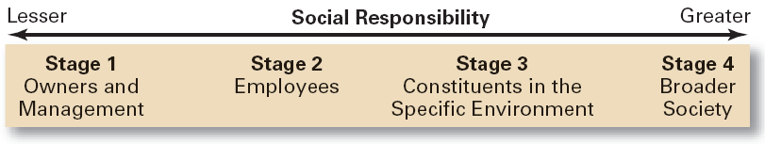
Exhibit 5–1 To Whom is Management Responsible?

Slide 10
Exhibit 5–2 Arguments For and Against Social Responsibility
For
  Public expectations
  Long-run profits
  Ethical obligation
  Public image
  Better environment
  Discouragement of further governmental regulation
  Balance of responsibility and power
  Stockholder interests
  Possession of resources
  Superiority of prevention over cure
Against
  Violation of profit maximization
  Dilution of purpose
  Costs
  Too much power
  Lack of skills
  Lack of accountability

Slide 11
From Obligation to Responsiveness to Responsibility
Social Obligation
  The obligation of a business to meet its economic and legal responsibilities and nothing more.
Social Responsiveness
  When a firm engages in social actions in response to some popular social need.
Social Responsibility
  A business’s intention, beyond its legal and economic obligations, to do the right things and act in ways that are good for society.

Slide 12
Exhibit 5–3 Social Responsibility versus Social Responsiveness
Social Responsibility Social Responsiveness
Major consideration Ethical Pragmatic
Focus Ends Means
Emphasis Obligation Responses
Decision framework Long term Medium and short term
Source: Adapted from S.L. Wartick and P.L. Cochran, “The Evolution of the Corporate Social Performance Model,” Academy of Management Review, October 1985, p. 766.

Slide 13
Does Social Responsibility Pay?
Studies appear to show a positive relationship between social involvement and the economic performance of firms.
  Difficulties in defining and measuring “social responsibility” and “economic performance raise issues of validity and causation in the studies.
  Mutual funds using social screening in investment decisions slightly outperformed other mutual funds.
A general conclusion is that a firm’s social actions do not harm its long-term performance.

Slide 14
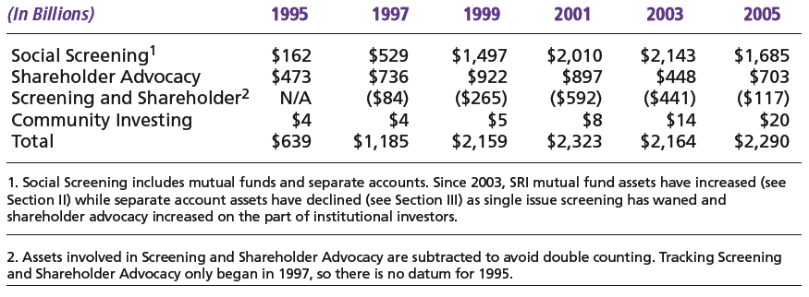
Exhibit 5–4 Social Investing
Source: Social Investment Forum Foundation.

Slide 15

The Greening of Management
The recognition of the close link between an organization’s decision and activities and its impact on the natural environment.
  Global environmental problems facing managers:
    Air, water, and soil pollution from toxic wastes
    Global warming from greenhouse gas emissions
    Natural resource depletion

Slide 16
How Organizations Go Green
Legal (or Light Green) Approach
  Firms simply do what is legally required by obeying laws, rules, and regulations willingly and without legal challenge.
Market Approach
  Firms respond to the preferences of their customers for environmentally friendly products.
Stakeholder Approach
  Firms work to meet the environmental demands of multiple stakeholders—employees, suppliers, and the community.
Activist Approach
  Firms look for ways to respect and preserve environment and be actively socially responsible.

Slide 17
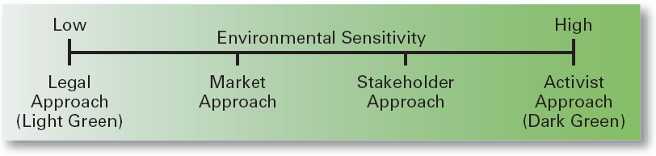
Exhibit 5–5 Approaches to Being Green
Source: Based on R.E. Freeman. J. Pierce, and R. Dodd. Shades of Green: Business Ethics and the Environment (New York: Oxford University Press, 1995).

Slide 18

Evaluating the Greening of Management
Organizations become “greener” by
  Using the Sustainability Reporting Guidelines to document “green” actions.
  Adopting ISO 14001 standards for environmental management
  Being named as one of the 100 Most Sustainable Corporations in the World.

Slide 19
Values-Based Management
Values-Based Management
  An approach to managing in which managers establish and uphold an organization’s shared values.
The Purposes of Shared Values
  Guiding managerial decisions
  Shaping employee behavior
  Influencing the direction of marketing efforts
  Building team spirit
The Bottom Line on Shared Corporate Values
  An organization’s values are reflected in the decisions and actions of its employees.

Slide 20
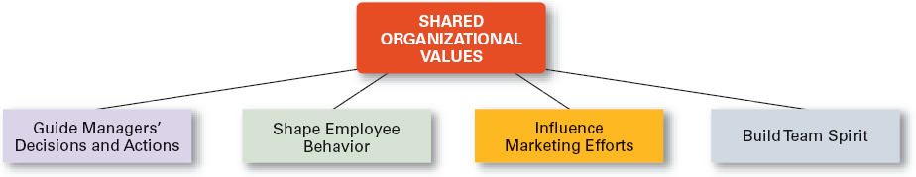
Exhibit 5–6 Purposes of Shared Values

Slide 21
Exhibit 5–7 Survey of Stated Values of Organizations
Percentage of
Core Value Respondents
Customer satisfaction 77%
Ethics/integrity 76%
Accountability 61%
Respect for others 59%
Open communication 51%
Profitability 49%
Teamwork 47%
Innovation/change 47%
Continuous learning 43%
Positive work environment 42%
Diversity 41%
Community service 38%
Trust 37%
Social responsibility 33%
Security/safety 33%
Empowerment 32%
Employee job satisfaction 31%
Have fun 24%
Source: “AMA Corporate Values Survey,” (www.amanet.org), October 30, 2002.

Slide 22
Managerial Ethics
Ethics Defined
  Principles, values, and beliefs that define what is right and wrong behavior.

Slide 23
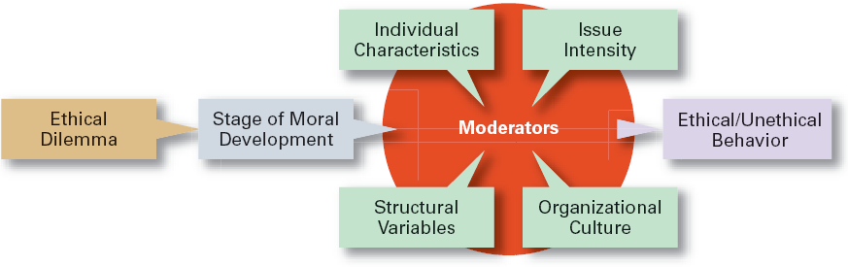
Exhibit 5–8 Factors That Affect Ethical and Unethical Behavior

Slide 24
Factors That Affect Employee Ethics
Moral Development
  A measure of independence from outside influences
    Levels of Individual Moral Development
      Preconventional level
      Conventional level
      Principled level
  Stage of moral development interacts with:
    Individual characteristics
    The organization’s structural design
    The organization’s culture
    The intensity of the ethical issue

Slide 25
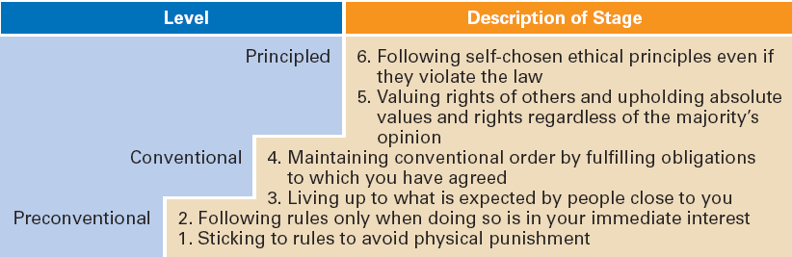
Exhibit 5–9 Stages of Moral Development
Source: Based on L. Kohlberg, “Moral Stages and Moralization: The Cognitive-Development Approach,” in T. Lickona (ed.). Moral Development and Behavior: Theory, Research, and Social Issues (New York: Holt, Rinehart & Winston, 1976), pp. 34–35.

Slide 26
Factors That Affect Employee Ethics (cont’d)
Moral Development
  Research Conclusions:
    People proceed through the stages of moral development sequentially.
    There is no guarantee of continued moral development.
    Most adults are in Stage 4 (“good corporate citizen”).

Slide 27
Individual Characteristics Affecting Ethical Behaviors
Values
  Basic convictions about what is right or wrong on a broad range of issues

Slide 28
Individual Characteristics
Personality Variables
  Ego strength
    A personality measure of the strength of a person’s convictions
  Locus of Control
    A personality attribute that measures the degree to which people believe they control their own life.
    Internal locus: the belief that you control your destiny.
    External locus: the belief that what happens to you is due to luck or chance.

Slide 29
Other Variables
Structural Variables
  Organizational characteristics and mechanisms that guide and influence individual ethics:
    Performance appraisal systems
    Reward allocation systems
    Behaviors (ethical) of managers
An Organization’s Culture
Intensity of the Ethical Issue

Slide 30
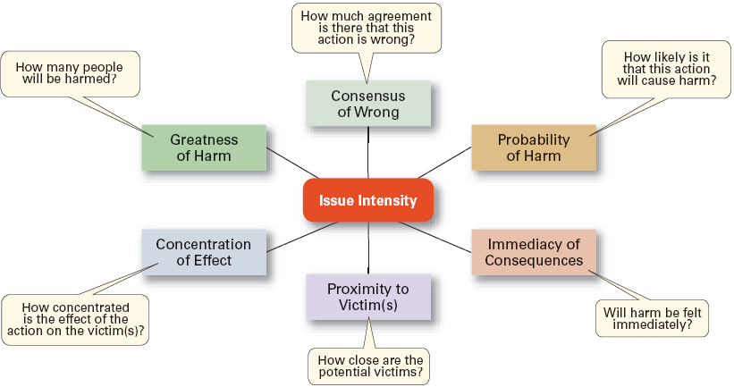
Exhibit 5–10 Determinants of Issue Intensity

Slide 31

Ethics in an International Context
Ethical standards are not universal.
  Social and cultural differences determine acceptable behaviors.
Foreign Corrupt Practices Act
  Makes it illegal to corrupt a foreign official yet “token” payments to officials are permissible when doing so is an accepted practice in that country.
The Global Compact

Slide 32
Exhibit 5–11 The Global Compact
Human Rights
Principle 1: Support and respect the protection of international human rights within their sphere of influence.
Principle 2: Make sure business corporations are not complicit in human rights abuses.
Labor Standards
Principle 3: Freedom of association and the effective recognition of the right to collective bargaining.
Principle 4: The elimination of all forms of forced and compulsory labor.
Principle 5: The effective abolition of child labor.
Principle 6: The elimination of discrimination in respect of employment and occupation.
Environment
Principle 7: Support a precautionary approach to environmental challenges.
Principle 8: Undertake initiatives to promote greater environmental responsibility.
Principle 9: Encourage the development and diffusion of environmentally friendly
technologies.
Source: Courtesy of Global Compact.

Slide 33
How Managers Can Improve Ethical Behavior in An Organization
Hire individuals with high ethical standards.
Establish codes of ethics and decision rules.
Lead by example.
Set realistic job goals and include ethics in performance appraisals.
Provide ethics training.
Conduct independent social audits.
Provide support for individuals facing ethical dilemmas.

Slide 34
The Value of Ethics Training
Can make a difference in ethical behaviors.
Increases employee awareness of ethical issues in business decisions.
Clarifies and reinforces the organization’s standards of conduct.
Helps employees become more confident that they will have the organization’s support when taking unpopular but ethically correct stances.

Slide 35
Exhibit 5–12 Clusters of Variables Found in 83 Corporate Codes of Business Ethics
Cluster 1. Be a Dependable Organizational Citizen
1. Comply with safety, health, and security regulations.
2. Demonstrate courtesy, respect, honesty, and fairness.
3. Illegal drugs and alcohol at work are prohibited.
4. Manage personal finances well.
5. Exhibit good attendance and punctuality.
6. Follow directives of supervisors.
7. Do not use abusive language.
8. Dress in business attire.
9. Firearms at work are prohibited.
Cluster 3. Be Good to Customers
1. Convey true claims in product advertisements.
2. Perform assigned duties to the best of your ability.
3. Provide products and services of the highest quality.
Cluster 2. Do Not Do Anything Unlawful or Improper That Will Harm the Organization
1. Conduct business in compliance with all laws.
2. Payments for unlawful purposes are prohibited.
3. Bribes are prohibited.
4. Avoid outside activities that impair duties.
5. Maintain confidentiality of records.
6. Comply with all antitrust and trade regulations.
7. Comply with all accounting rules and controls.
8. Do not use company property for personal benefit.
9. Employees are personally accountable for company funds.
10. Do not propagate false or misleading information.
11. Make decisions without regard for personal gain.
Source: F. R. David, “An Empirical Study of Codes of Business Ethics: A Strategic Perspective,” paper presented at the 48th Annual Academy of Management Conference, Anaheim, California, August 1988.

Slide 36
Exhibit 5–13 Twelve Questions for Examining the Ethics of a Business Decision
Have you defined the problem accurately?
How would you define the problem if you stood on the other side of the fence?
How did this situation occur in the first place?
To whom and to what do you give your loyalty as a person and as a member of the corporation?
What is your intention in making this decision?
How does this intention compare with the probable results?
Whom could your decision or action injure?
Can you discuss the problem with the affected parties before you make the decision?
Are you confident that your position will be as valid over a long period of time as it seems now?
Could you disclose without qualm your decision or action to your boss, your chief executive officer, the board of directors, your family, society as a whole?
What is the symbolic potential of your action if understood? If misunderstood?
Under what conditions would you allow exceptions to your stand?
Source: Reprinted by permission of Harvard Business Review. An exhibit from “Ethics Without the Sermon,” by L. L. Nash. November–December 1981, p. 81. Copyright © 1981 by the President and Fellows of Harvard College. All rights reserved.

Slide 37
Effective Use of a Code of Ethics
Develop a code of ethics as a guide in handling ethical dilemmas in decision making.
Communicate the code regularly to all employees.
Have all levels of management continually reaffirm the importance of the ethics code and the organization’s commitment to the code.
Publicly reprimand and consistently discipline those who break the code.

Slide 38
Ethical Leadership
Managers must provide a good role model by:
  Being ethical and honest at all times.
  Telling the truth; don’t hide or manipulate information.
  Admitting failure and not trying to cover it up.
  Communicating shared ethical values to employees through symbols, stories, and slogans.
  Rewarding employees who behave ethically and punish those who do not.
  Protecting employees (whistleblowers) who bring to light unethical behaviors or raise ethical issues.

Slide 39
Managing Ethical Lapses and Social Irresponsibility
Provide ethical leadership
Protect employees who raise ethical issues (whistle-blowers)

Slide 40

Awareness of Social Issues
Social Entrepreneurs
  Are individuals or organizations who seek out opportunities to improve society by using practical, innovative, and sustainable approaches.
  Want to make the world a better place and have a driving passion to make that happen.

Slide 41
Awareness of Social Issues (cont’d)
Social Impact Management
  Is the field of inquiry at the intersection of business practice and wider societal concerns that reflects and respects the complex interdependency of those two realities.
  Seeks to answer the question of how to go about increasing managers’ awareness within their decision-making processes of how society is impacted by the conduct and activities of their firms.

Slide 42
Terms to Know
classical view
socioeconomic view
social obligation
social responsiveness
social responsibility
social screening
greening of management
values-based management
ethics
values
ego strength
locus of control
code of ethics
whistle-blower
social entrepreneur
social impact management

